Slide 1

The Battle of Neighborhoods
Project for Coursera course Applied Data Science Capstone

Slide 2

Introduction
Most important thing for establishing a great restaurant is choose true location. For choose true location you need to consider many parameters. First parameter is nearby restaurant to purpose society.

Slide 3
Introduction
In this study we want to investigate about establishing a Filipino restaurant in a big city and my case study city is Toronto.
First group of my purpose society is Filipino and then other Asians, then I prefer to choose the locations of the restaurant nearby of this two groups.

Slide 4
Introduction
Other important parameter is household income and we should choose a location that average of household income is enough four getting a food from restaurants.

Slide 5
Methodology
First all data such as neighborhood, postal code, Filipino population, income and, latitude, longitude … combined. The statistical data are plot on Toronto map, which can give an initial impression of areas having highest Chinese population, and highest average income. Foursquare API was used to find the restaurant count.

Slide 6
Methodology
K-Mean clustering algorithms are used to analyses a Filipino Population, restaurant count and people with Asian origin as the purpose society. The result help for find best place to run a new Filipino restaurant plan.

Slide 7
Statistics data

Slide 8
Map of each neighborhood’s average income.

Slide 9
Find corresponding postcode of each neighborhood from Wikipedia table.

Slide 10
Combine statistics data and geospatial data

Slide 11
Full table of Toronto Neighborhood with Postcode, statistics, and restaurant count

Slide 12
Toronto Neighborhood with cluster labels.

Slide 13
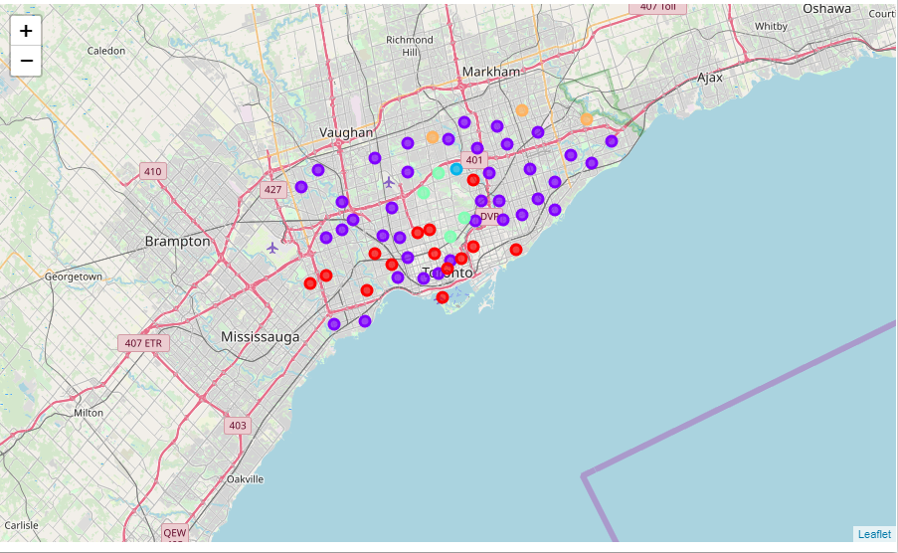
Divide Toronto neighborhood to some clusters based on the population and income

Slide 14
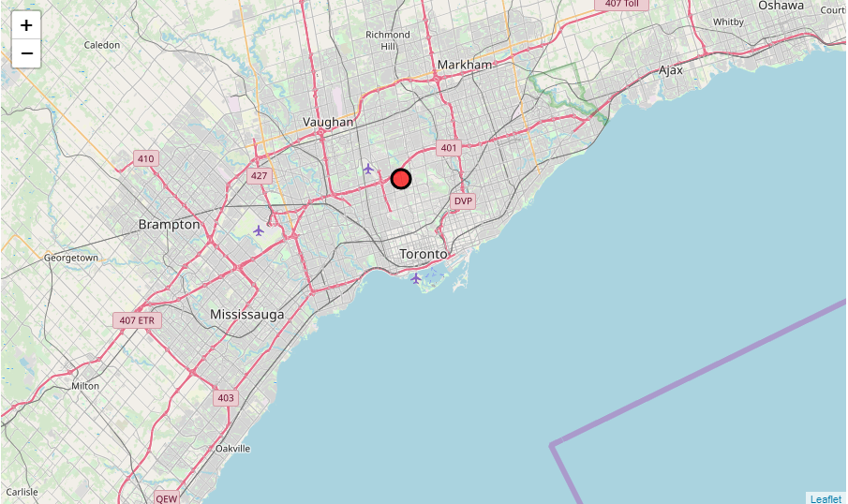
Neighborhoods good to open a new high-class Filipino restaurant.

Slide 15
Conclusion
-In this study I try to consider the most important
Parameters such as locations , population, average income , and nearby to others Filipino restaurant. Of course , it's so challenging but I try to choose best locations to earn best result.
-Brooke Avenue and neighborhoods are best place for running a Filipino restaurant in Toronto.

